Slide 1


How Web Services Work?
Web Services
[Services available over the web]
To enable communication between two applications
Request
Application developed using Java
Application developed using .NET
Response

Slide 2
How Web Services Work?
Example: While Speaking over the telephone, Medium the Phone and Format is the common language (e.g. English) that both of you can understand.
Medium – HTTP/INTERNET
Format – XML/JSON
A web service provider develops/implements the application (Web Service) and makes it available over the Internet.
Request
Client
(Service Consumer)
Server
(Service Provider)
Response

Slide 3
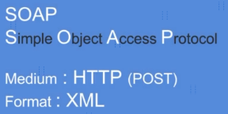
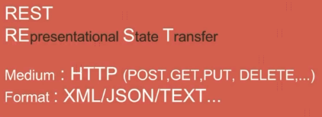
How Web Services Work?

Slide 4
What is a Web Service?
https://www.udemy.com/course/web-services-api-step-by-step-beginner-tutorial/learn/lecture/10047718#overview

